Slide 1
Action – Arrange Transport
JCPickup record Created
JC: ApproveForTransport
JC: Pickup
JCPickup: Open
Action – Start for Pickup
JC: Pickup
JCPickup: StartedPickup
Action – Reached Customer
JC: Pickup
JCPickup: ReachedCustomer
JC: Open
Action – Vehicle Picked Up
JC: Pickup
JCPickup: Pickedup
RS Manager
Action – Close Pickup Ticket
JC: Pickup
JCPickup: Closed
RS Technician (on the vehicle)
miBud
JC: ClosedApproved
Action – Approve Service
Action – Reject Service
RSAngel Mechanik
Ops workflow
JC: ClosedDisapproved

Slide 2
miBud

Slide 3
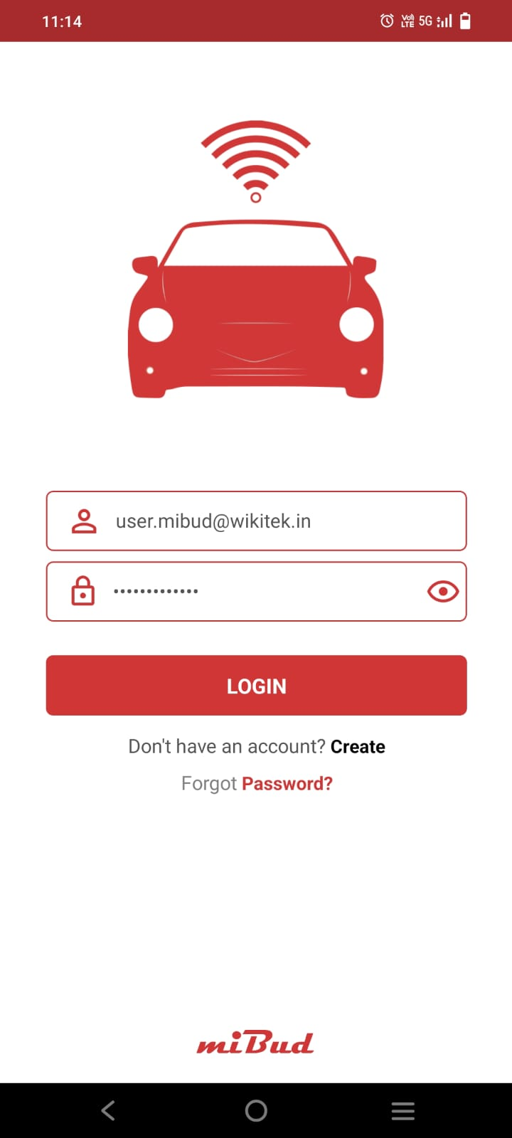
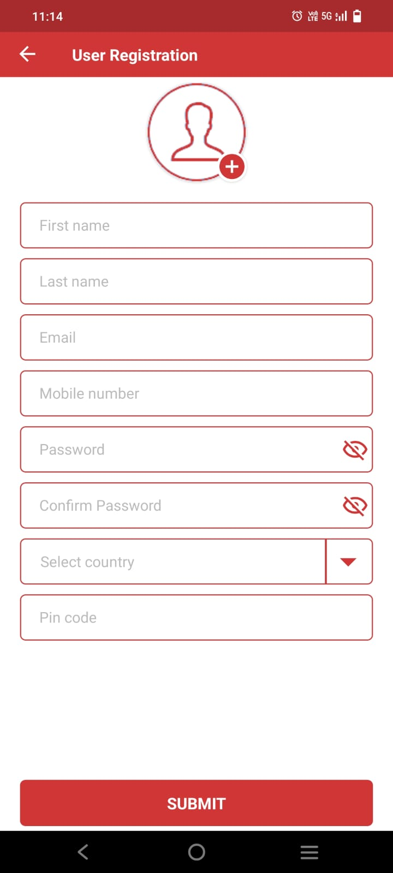
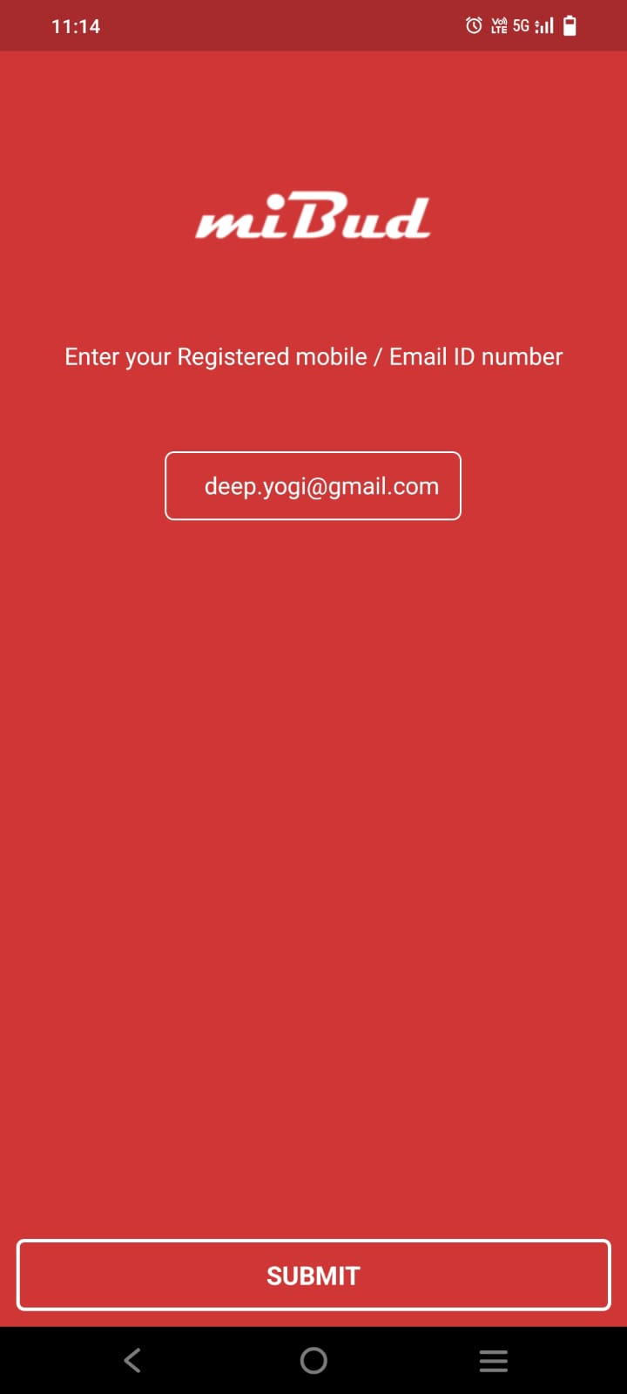
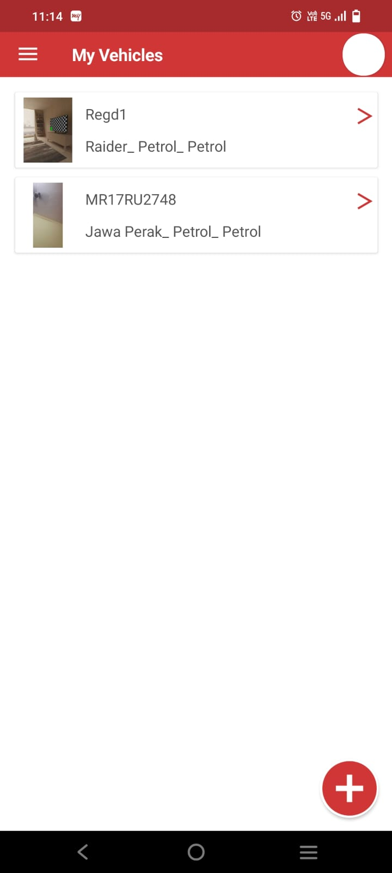
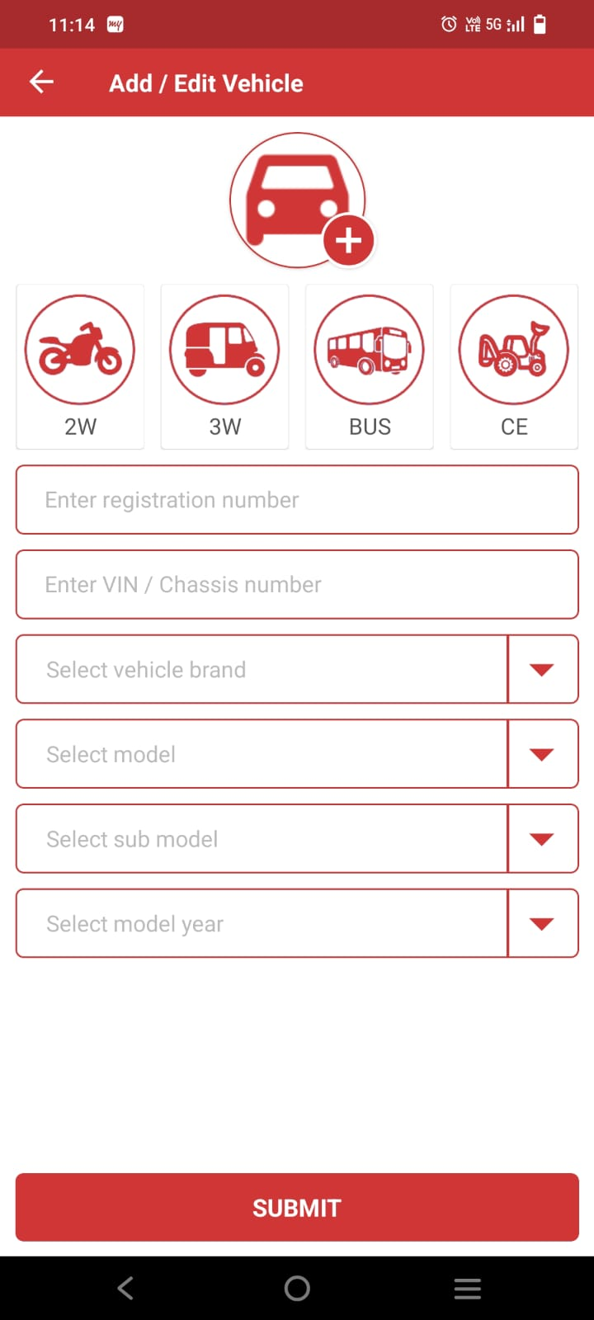
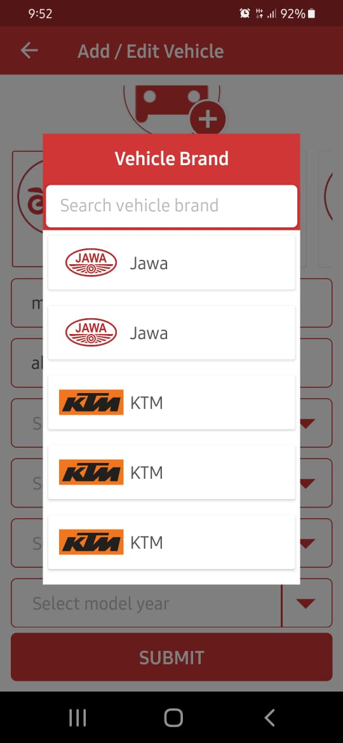
Provide login by otp also as an option. Instead of forgot password, put OTP Login. This way, he can login and later change his password inside
Use only mobile number. No email required. Until otp authentication happens, don’t approve the user. Until user is approved, he cannot login
This screen will not be there as we will not have forgot password option
Remove the circle on top right.
Remove the > symbol, once vehicle is crated, it cannot be edited / changed
when new vehicle is created, have blank page and say Add vehicle.
We shud have brands shown only once. Same with model, submodel, modelyear

Slide 4
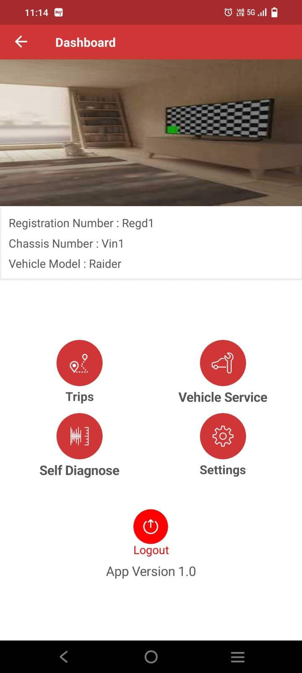
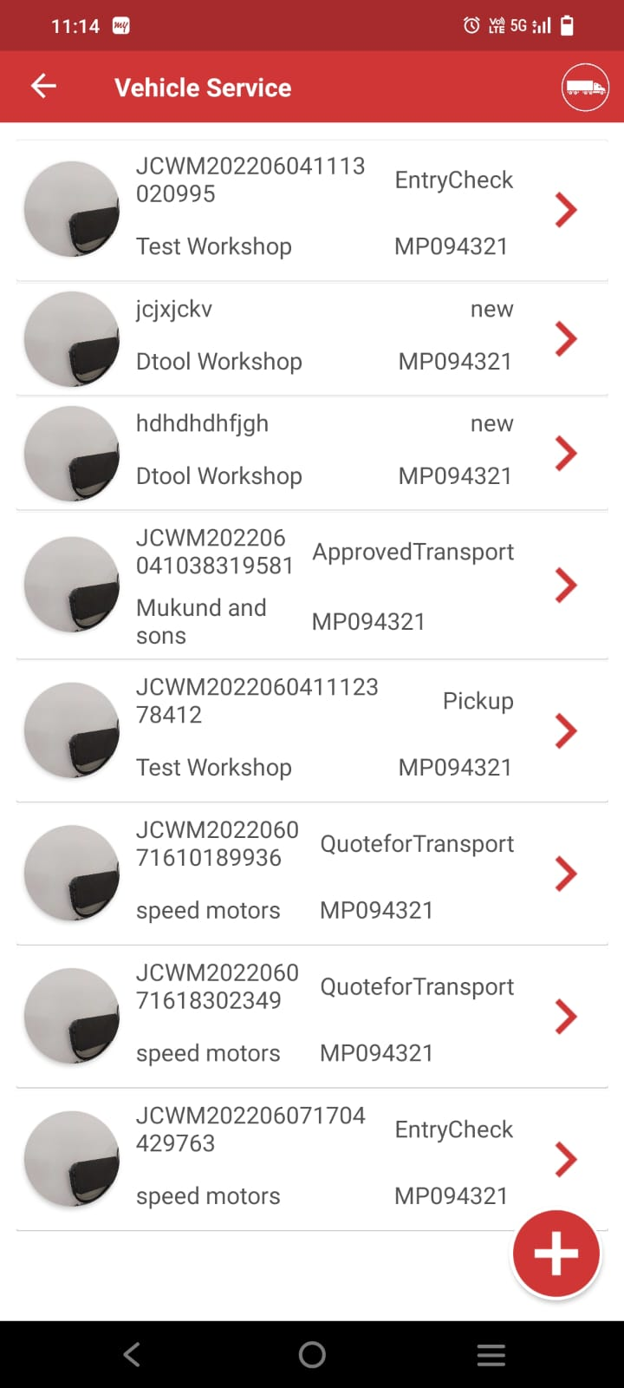
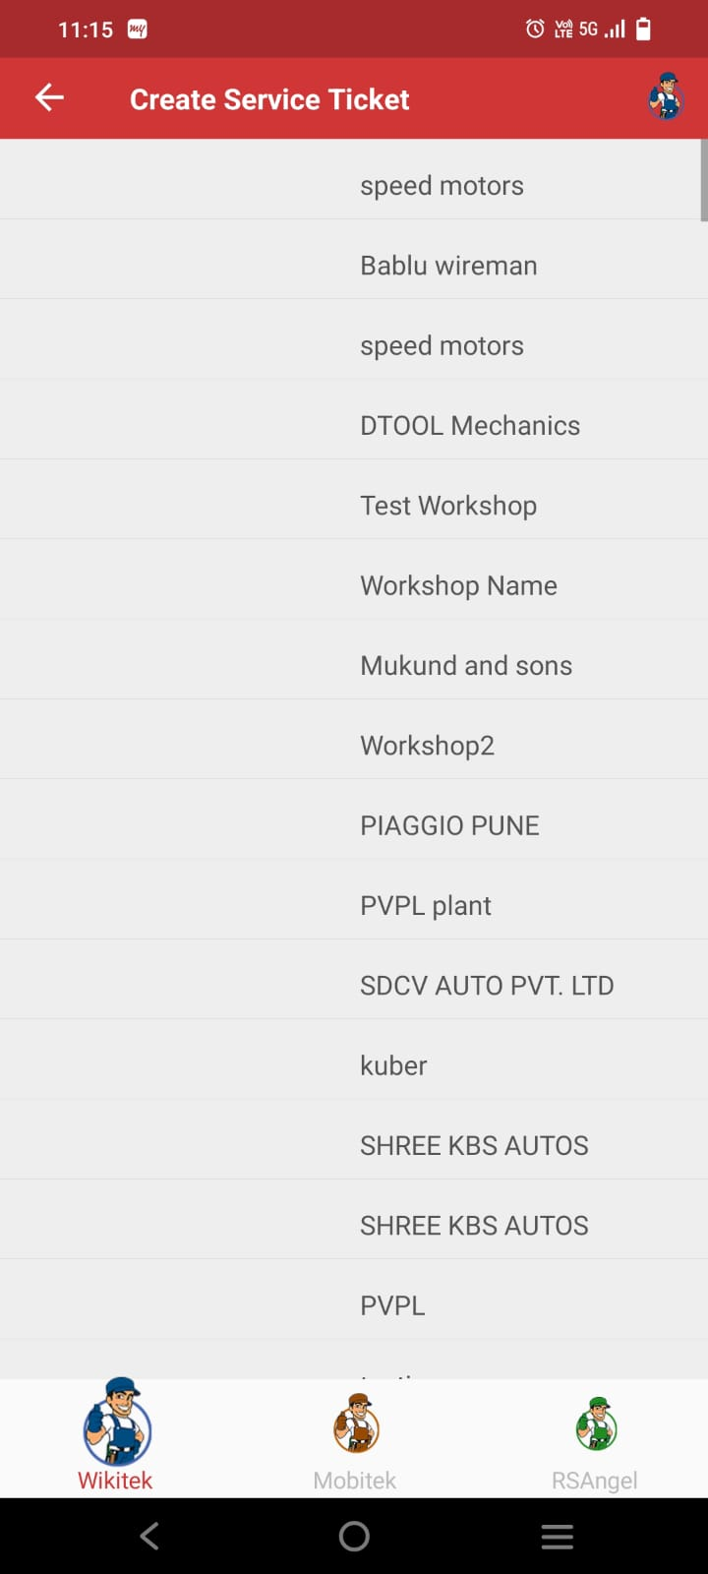
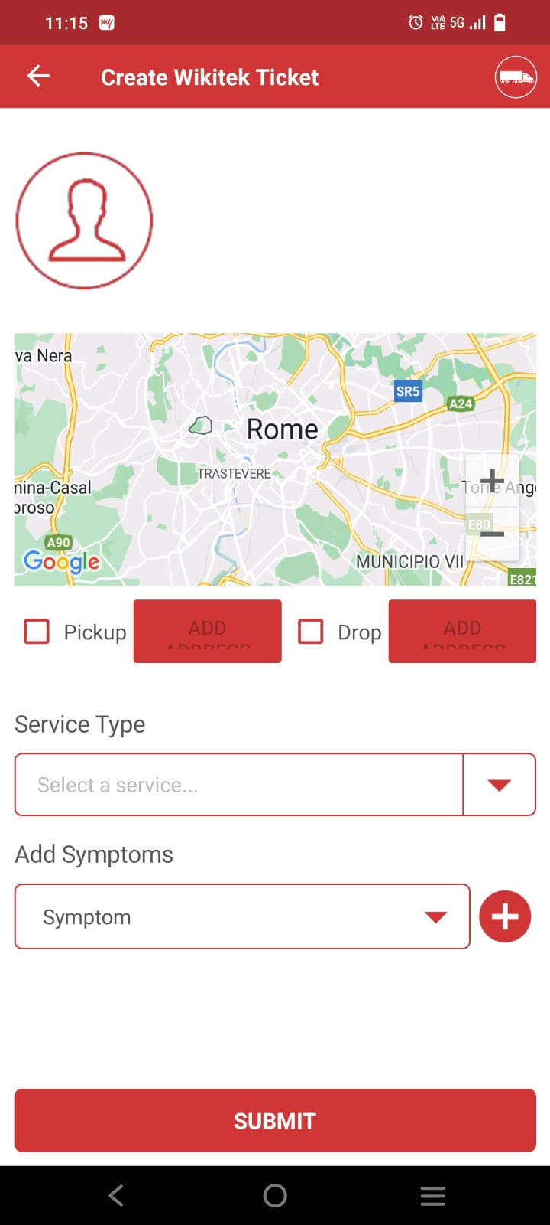
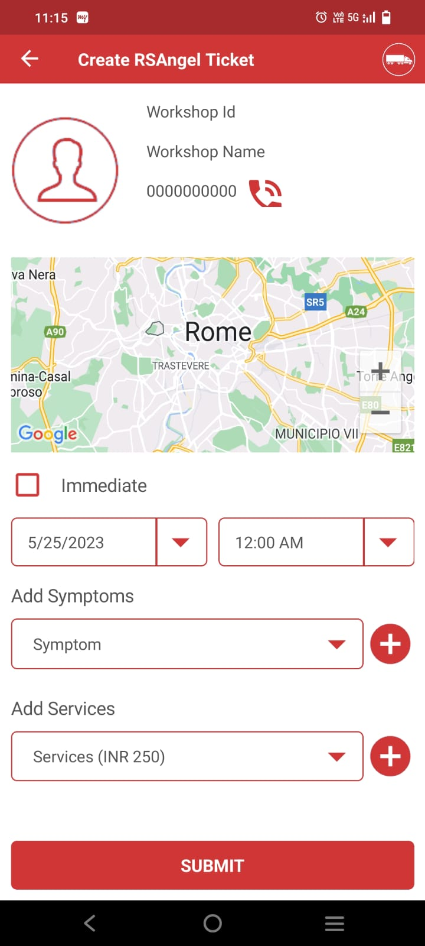
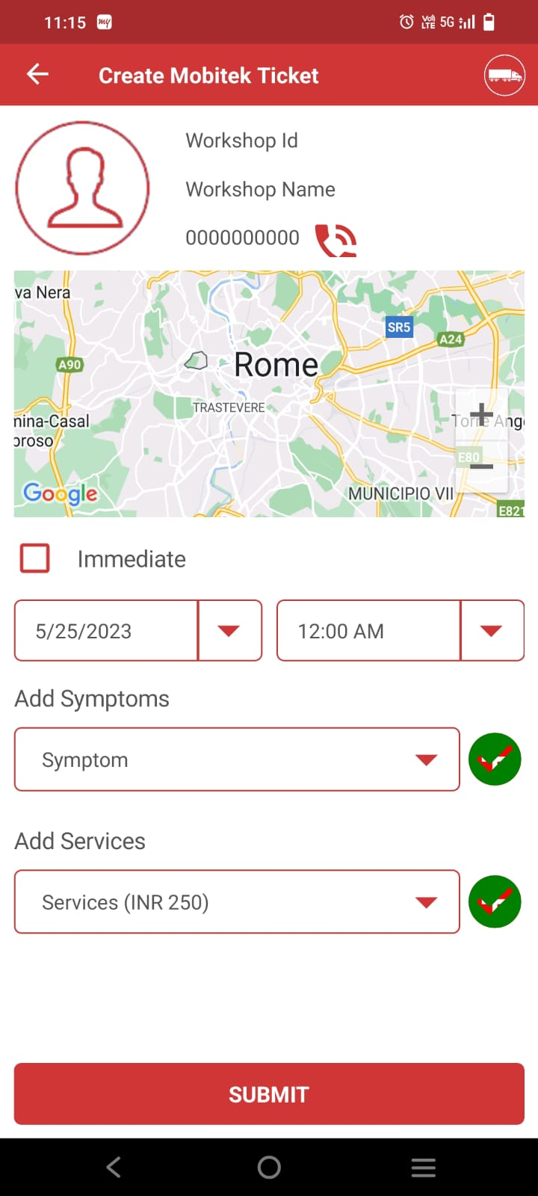
Remove Trips. Settings and logout from here. First line would have Wikitek Mechanik, Mobitek Mechanik, RSAngel Mechanik
Second line would have Self Diagnose
Based on which one is selected, show only those service ticket (by user type)
Based on which user type is selected, show appropriate pic on top right. Remove the link from that. Show only those user types on map. Below remove the 3 icons. And have book nearest, and book selected only. Once this is clicked, display next service detail page
Based on which user type is selected, show appropriate pic on top right. Remove the link from that. Show only those user types on map. Below remove the 3 icons. And have book nearest, and book selected only. If picture not attached, show workshop icon here. Map should show route from current to workshop. If pickup / drop enabled, add date and time. Select one service type and one or more symptoms
In case on mobitek / rsangel, only service date and time would be shown.
Workshop ID
Workshop Name
Address:
This will book the service ticket

Slide 5
Shud be able to add multiple symptoms and multiple services. By default immediate clicked and current date and time should show up but disabled, if Immediate disabled, current date time can be changed. Remove mobile number from these pages and replace with Rating (5 star). We will introduce soon in the backend. Get rid of + buttons. We shud be able to add multiple in the same box (with search)
Map should show the vehicle that is book in moving condition.
Opening existing job cards
Map view with the vehicle moving
JCxxx
For Status: Pickup (Closed), Action – Approve Job Card / Reject Job Card at the end
Move up to do any action and look at details
V
JCxxx <Status>
<Veh Reg No> <Technician Name>

Slide 6
wikitek1

Slide 7


RSAngel
RS Manager section
RS Technician section
Map of the vehicle moving
Map of the vehicle moving
Vehicle Service
JCxxx (Status)
<Veh Reg No>
JCxxx (Status)
<Veh Reg No>
Available / All
Available / All
For Status: Arrange for Transport
Action – Approve / change vehicle and approve
For Status: Pickup (Open) - Action – Start for Pickup
For Status: Pickup (Started Pickup) – Action – Reached Customer
For Status: Pickukp (Reached Customer), Action – OTP + Vehicle Pickedup
For Status: Pickup (Pickedup), Action – Close Pickup
+
V
V
<Customer Name>
<Mobile No>
<Customer Name>
<Mobile No>

Slide 8







Wikitek1 (User Type – RSAngel)
Only appears for managers
Registration
Vehicle Mgmt
Technician Mgmt
Dashboard
Marketplace
My Orders
Select Language
Sync Data
Logout
DASHBOARD
Vehicle Management
Map view with my vehicle locations and details. Also, if they are free / busy. If vehicle selected, only show that on the map
Vehicle Management
First Name
Scrolling pics
KA01 DA 0099
Free
Select Vehicle Number
Last Name
xxx hrs / xxx hrs
Technician
Select User Type
KA01 DA 0010
Free
Select Vehicle Segment
xxx hrs / xxx hrs
Technician
KA01 DA 0012
Free
Email ID
xxx hrs / xxx hrs
Technician
Mobile No
Diagnostics
Assisted Diagnostics
Operations
Password
Hot Products
Confirm Password
Select Country
Pincode
Vehicle Reg no
+
Status
submit
Technician

Slide 9

api/v1/workshops/associate-vehicle0099
api/v1/workshops/vehicle-disassociate99
api/v1/workshops/vehicle-technician-associate99
Associate Vehicle
Disassociate Vehicle
KA01 DA 0099
Assign Technician
Enter Vehicle Reg No
Select Vehicle Reg No
Reg No: xxx
VIN No: xxx
Owner: x x
Run Hrs: xxx hrs / xxx hrs
Status: Associated
Reg No: xxx
VIN No: xxx
Owner: x x
Run Hrs: xxx hrs / xxx hrs
Status: Associated
Get OTP
Reg No: xxx
VIN No: xxx
Owner: x x
Run Hrs: xxx hrs / xxx hrs
Status: Associated
Select Available Technician
Assign Technician
Start Date time
Send OTP
Get OTP
Disassociate
End Date Time
api/v1/workshops/confirm-vehicle-association0099
Get OTP
Send OTP
api/v1/workshops/confirm-vehicle-disassociation9
Send OTP
api/v1/workshops/confirm-vehicle-technician-association99
Only get unassociated technicians
Only get available technicians

Slide 10
api/v1/workshops/associate-technician99
api/v1/workshops/vehicle-technician-associate99
api/v1/workshops/technician-disassociate99
Technician Management
Add Technician
Username
Assign Vehicle
Disassociate Technician
User Name
User ID
Enter Technician ID
User ID: xxx
User Name: xxx
User Type:
Status: Associated
User ID: xxx
User Name: xxx
User Type:
Status: Associated
User ID: xxx
User Name: xxx
User Type:
Status: Associated
Status
Availability
Get OTP
User Name
User ID
Status
Availability
Select Available Vehicle
Select Technician
User Name
User ID
Assign Vehicle
Start Date time
Get OTP
Status
Availability
Send OTP
End Date Time
Disassociate
api/v1/workshops/confirm-technician-association0099
Get OTP
Send OTP
Send OTP
+
api/v1/workshops/confirm-vehicle-technician-association99
api/v1/workshops/confirm-vehicle-disassociation9
Only get disassociated technicians
Only get available vehicles

